Slide 1
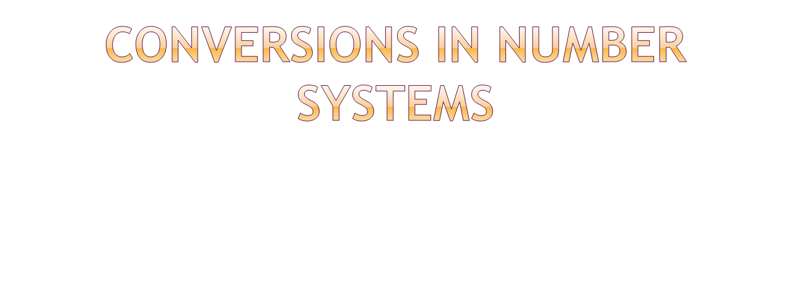
By
M. BABY ANUSHA,
ASST.PROF IN CSE DEPT.,
RGUKT,NUZVID

Slide 2

System | Base | Symbols | Used by humans? | Used in computers?
Decimal | 10 | 0, 1, … 9 | Yes | No
Binary | 2 | 0, 1 | No | Yes
Octal | 8 | 0, 1, … 7 | No | No
Hexa- decimal | 16 | 0, 1, … 9, A, B, … F | No | No

Slide 3
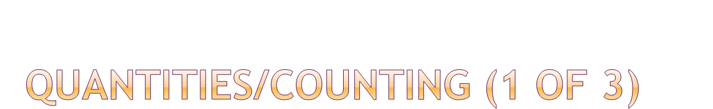
Decimal | Binary | Octal | Hexa- decimal
0 | 0 | 0 | 0
1 | 1 | 1 | 1
2 | 10 | 2 | 2
3 | 11 | 3 | 3
4 | 100 | 4 | 4
5 | 101 | 5 | 5
6 | 110 | 6 | 6
7 | 111 | 7 | 7
p. 33

Slide 4
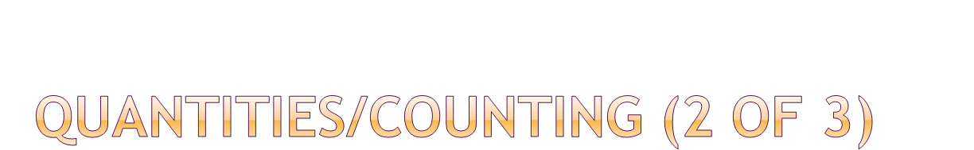
Decimal | Binary | Octal | Hexa- decimal
8 | 1000 | 10 | 8
9 | 1001 | 11 | 9
10 | 1010 | 12 | A
11 | 1011 | 13 | B
12 | 1100 | 14 | C
13 | 1101 | 15 | D
14 | 1110 | 16 | E
15 | 1111 | 17 | F

Slide 5

Decimal | Binary | Octal | Hexa- decimal
16 | 10000 | 20 | 10
17 | 10001 | 21 | 11
18 | 10010 | 22 | 12
19 | 10011 | 23 | 13
20 | 10100 | 24 | 14
21 | 10101 | 25 | 15
22 | 10110 | 26 | 16
23 | 10111 | 27 | 17
Etc.

Slide 6

The possibilities:
Decimal
Octal
Binary
Hexadecimal
pp. 40-46

Slide 7

25₁₀ = 11001₂ = 31₈ = 19₁₆
Base

Slide 8
Weight
125₁₀ => 5 x 10⁰ = 5
2 x 10¹ = 20
1 x 10² = 100
125
Base

Slide 9

Decimal
Octal
Binary
Hexadecimal

Slide 10
Technique
  Multiply each bit by 2^{n}, where n is the “weight” of the bit
  The weight is the position of the bit, starting from 0 on the right
  Add the results

Slide 11

Bit “0”
101011₂ => 1 x 2⁰ = 1
1 x 2¹ = 2
0 x 2² = 0
1 x 2³ = 8
0 x 2⁴ = 0
1 x 2⁵ = 32
43₁₀

Slide 12

Decimal
Octal
Binary
Hexadecimal

Slide 13
Technique
  Multiply each bit by 8^{n}, where n is the “weight” of the bit
  The weight is the position of the bit, starting from 0 on the right
  Add the results

Slide 14
724₈ => 4 x 8⁰ = 4
2 x 8¹ = 16
7 x 8² = 448
468₁₀

Slide 15

Decimal
Octal
Binary
Hexadecimal

Slide 16
Technique
  Multiply each bit by 16^{n}, where n is the “weight” of the bit
  The weight is the position of the bit, starting from 0 on the right
  Add the results

Slide 17
ABC₁₆ => C x 16⁰ = 12 x 1 = 12
B x 16¹ = 11 x 16 = 176
A x 16² = 10 x 256 = 2560
2748₁₀

Slide 18

Decimal
Octal
Binary
Hexadecimal

Slide 19
Technique
  Divide by two, keep track of the remainder
  First remainder is bit 0 (LSB, least-significant bit)
  Second remainder is bit 1
  Etc.

Slide 20
125₁₀ = ?₂
2 125
62 1
2
31 0
2
15 1
2
7 1
2
3 1
2
1 1
2
0 1
125₁₀ = 1111101₂

Slide 21

Decimal
Octal
Binary
Hexadecimal

Slide 22
Technique
  Convert each octal digit to a 3-bit equivalent binary representation

Slide 23
705₈ = ?₂
7 0 5
111 000 101
705₈ = 111000101₂

Slide 24

Decimal
Octal
Binary
Hexadecimal

Slide 25
Technique
  Convert each hexadecimal digit to a 4-bit equivalent binary representation

Slide 26
10AF₁₆ = ?₂
1 0 A F
0001 0000 1010 1111
10AF₁₆ = 0001000010101111₂

Slide 27

Decimal
Octal
Binary
Hexadecimal

Slide 28
Technique
  Divide by 8
  Keep track of the remainder

Slide 29
1234₁₀ = ?₈
8 1234
154 2
8
19 2
8
2 3
8
0 2
1234₁₀ = 2322₈

Slide 30

Decimal
Octal
Binary
Hexadecimal

Slide 31
Technique
  Divide by 16
  Keep track of the remainder

Slide 32
1234₁₀ = ?₁₆
16 1234
77 2
16
4 13 = D
16
0 4
1234₁₀ = 4D2₁₆

Slide 33

Decimal
Octal
Binary
Hexadecimal

Slide 34
Technique
  Group bits in threes, starting on right
  Convert to octal digits

Slide 35
1011010111₂ = ?₈
1 011 010 111
1 3 2 7
1011010111₂ = 1327₈

Slide 36

Decimal
Octal
Binary
Hexadecimal

Slide 37
Technique
  Group bits in fours, starting on right
  Convert to hexadecimal digits

Slide 38
1010111011₂ = ?₁₆
10 1011 1011
B B
1010111011₂ = 2BB₁₆

Slide 39

Decimal
Octal
Binary
Hexadecimal

Slide 40
Technique
  Use binary as an intermediary

Slide 41
1076₈ = ?₁₆
1 0 7 6
001 000 111 110
2 3 E
1076₈ = 23E₁₆

Slide 42

Decimal
Octal
Binary
Hexadecimal

Slide 43
Technique
  Use binary as an intermediary

Slide 44
1F0C₁₆ = ?₈
1 F 0 C
0001 1111 0000 1100
1 7 4 1 4
1F0C₁₆ = 17414₈

Slide 45

Next topic

